Slide 1
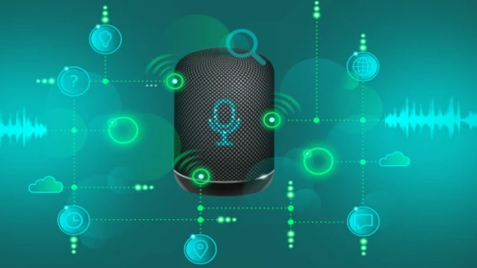
Speech Recognition using Hidden Markov Models
An Overview of HMM in Speech Recognition
D. V. Joshita Lavanya
L. Yamini Durga
K. Vaishnavi
C. Sai Charan
1

Slide 2


What is Speech Recognition?
So broadly speech recognition allows for the recognition and translation of human language into text. With modern advances in computing power, progress accelerated.
The launch of Google Voice Search in 2011 and Apple's Siri shortly after marked the beginning of a new era. Now, with around 4.2 billion voice assistant devices globally, the number could reach 8 billion by 2024.
2
Notes:
Speech recognition has come a long way since it’s first incarnation in 1952 which could recognize a single voice speaking digits aloud. Researchers at Bell Labs created the "Audrey" system, one of the earliest attempts at automatic speech recognition, where the systems were focused on numbers, not words, but the progress is very slow.
Transitioning from recognizing individual words to full sentences initially took 20 years. With modern advances in computing power, progress accelerated. The launch of Google Voice Search in 2011 and Apple's Siri shortly after marked the beginning of a new era. Now, with around 4.2 billion voice assistant devices globally, the number could reach 8 billion by 2024.

Slide 3

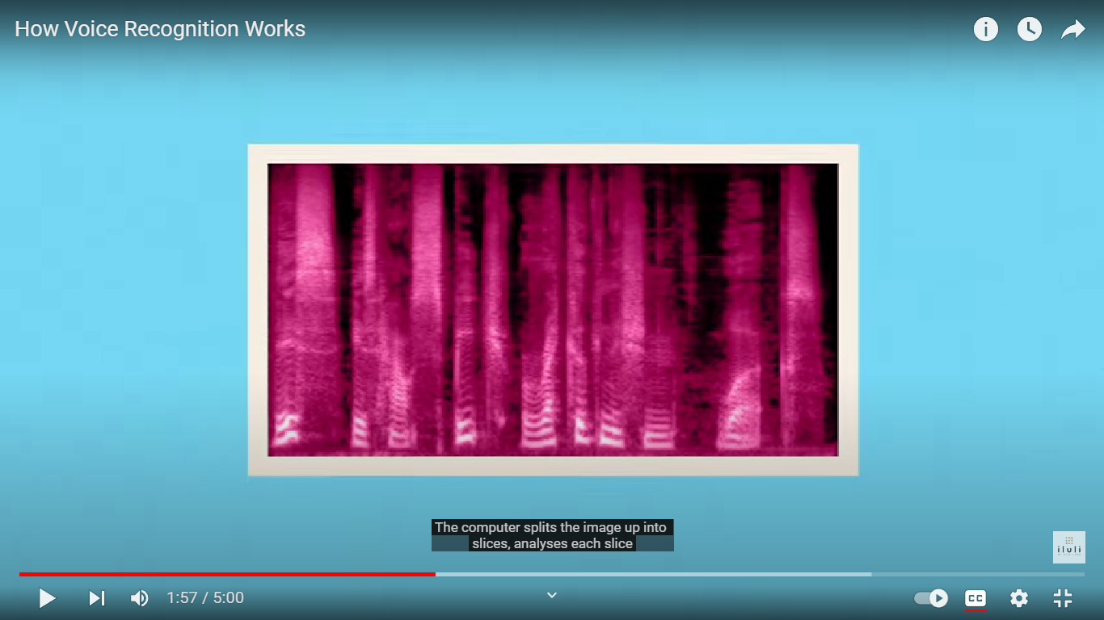
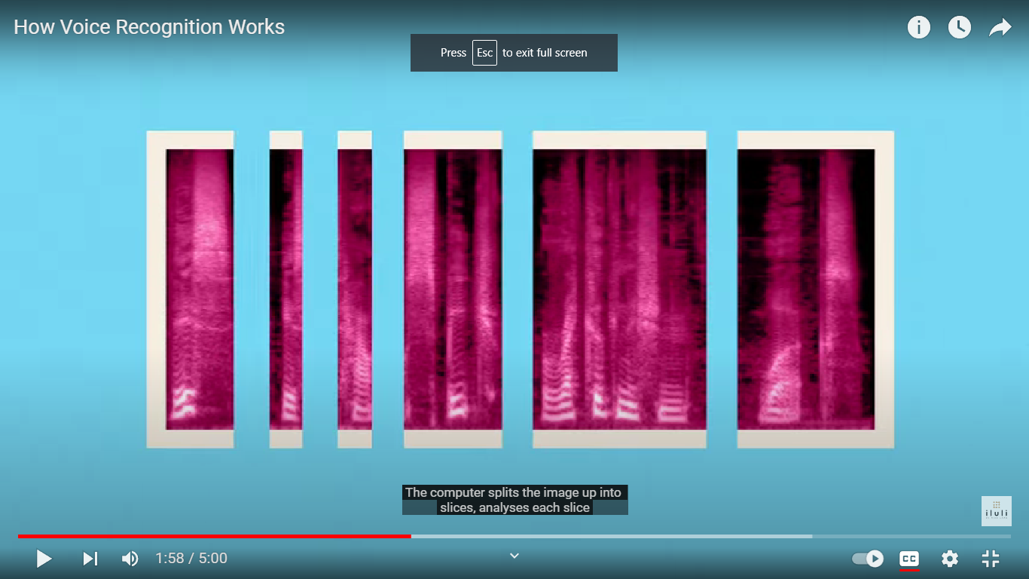
How can a computer recognize speech?
The computer dissects the image into slices.
The brighter the color the higher the concentration of that particular frequency.
Analyzing each one by comparing it to a known library of typical sound patterns. It identifies the most likely sound for each slice and considers previous slices to understand word construction patterns, showcasing its intelligent processing.
3
Notes:
This is spectrogram a visual representation of frequency content over time in an audio recording.
but there is catch human language isn't so simple, we all know that people speak with different accents slangs mispronunciations and these variations aren’t in the computers dictionary. this is where models such as hidden markov models come in.

Slide 4
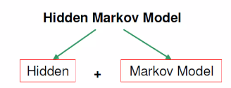
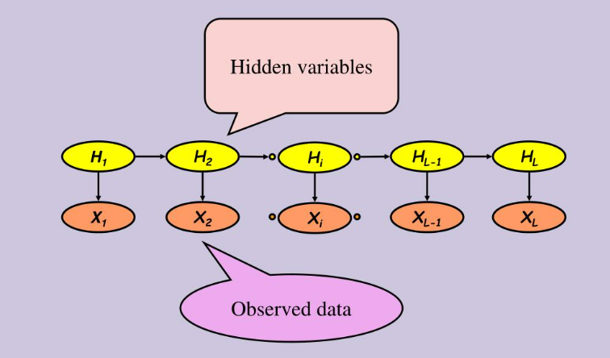
Hidden Markov Model(HMM)
A Hidden Markov model (statistical model) is a tool for representing probability distributions over sequences of observations, it allows us to observe some evidence at each timestep, which can potentially affect the belief distribution at each of the states.
HMMs consist of a set of states, transitions between states, and probabilities of emitting an output from each state. Here H1,H2..HL hidden states, X1..XL are emitting states.
4
Notes:
A Hidden Markov Model (HMM) is a mathematical model used to describe systems that change over time. The model deals with probabilities, predicting the likelihood of transitioning between states and generating specific observations.

Slide 5
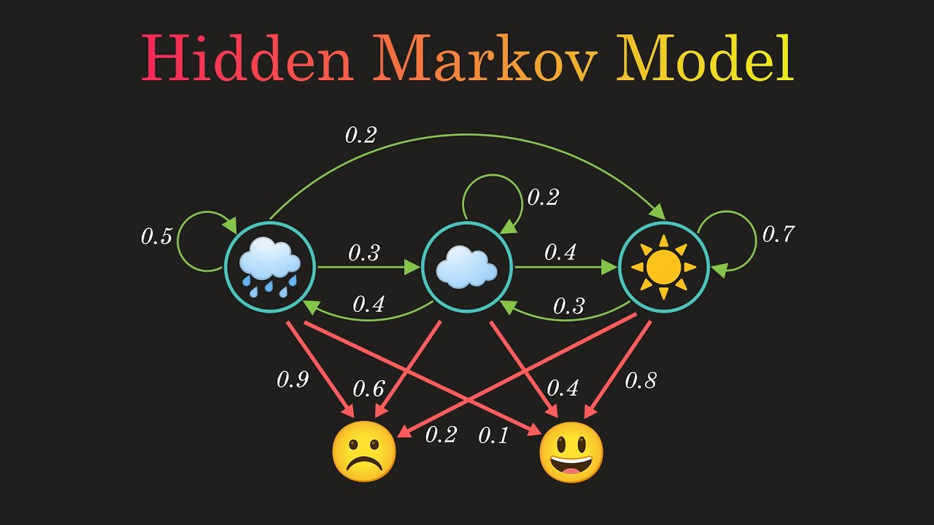
The Hidden states in our example is Weather.
Observed/emission is expression.
The hidden states directly impact the observed states.
Whereas in speech recognition, the hidden states might represent different phonemes, and the observations are the sounds produced. You don't directly observe the phonemes; you infer them from the speech signal.
5

Slide 6
Why HMM in Speech Recognition?
Statistical Framework
Temporal Modeling
Adaptability
Flexibility
6
Notes:
: HMMs provide a statistical framework for modeling uncertainty in speech.
: HMMs are well-suited for modeling temporal sequences, making them effective for capturing the dynamic nature of speech.
: HMMs can be adapted or trained on specific speakers or environments, making them adaptable to different conditions
: HMMs can model a wide range of probability distributions, allowing them to handle the variability in speech sounds.

Slide 7
Architecture for speech recognition
Acoustic Model
Speech input
text output
Feature Extraction
Decoding Search
Dictionary
7
Notes:
The STFT is a common preprocessing step in speech recognition to convert the time-domain audio signal into a frequency-domain representation.
The resulting raw array, representing the frequency content of each segment, can be used as features for training HMMs. These features capture the spectral characteristics of the speech signal, which is essential for modeling phonemes and words.

Slide 8
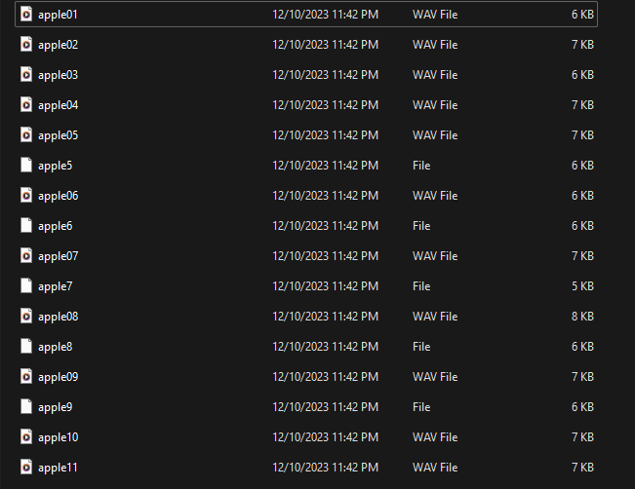
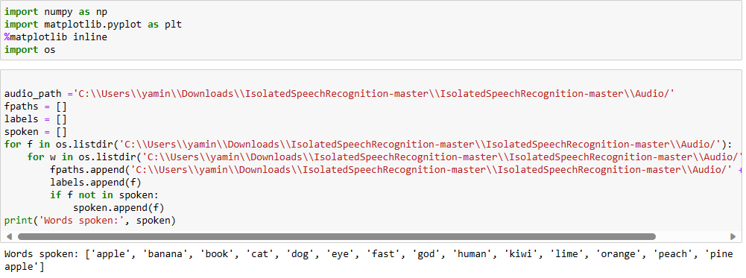
Dataset that we considered here is from github which is an audio folder containing 15 sub folders consisting 15 respective audio files in .wav format.
8

Slide 9
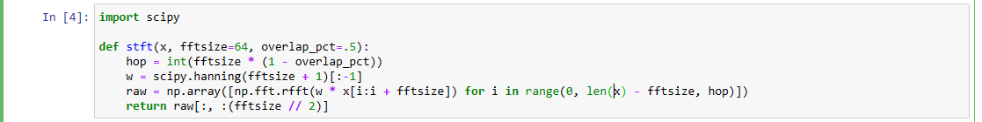
Feature Extraction
The Short-Time Fourier Transform is a common preprocessing step in speech recognition to convert the time-domain audio signal into a frequency-domain representation.
The resulting ‘raw’ array, representing the frequency content of each segment, can be used as features for training HMMs. So, this raw file is acting as dictionary for HMM
9

Slide 10
Acoustic Model
Acoustic model is used by the recognition system to recognize speech.
It takes feature vectors to creates a statistical representation of the sound for each word. These statistical representations are called HMM.
The code employs a Hidden Markov Model (HMM) framework for speech recognition. Each state in the HMM is associated with a GMM that models the probability distribution of the observed features given that state.
For each word category, evaluate the likelihood of the input sequence given the trained GMM-HMM using the transform method in the gmmhmm class.
Choose the word category with the highest likelihood as the recognized word.
10

Slide 11
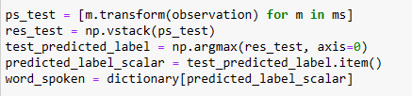
Decoding Search
The audio input, use the Viterbi algorithm to find the most likely sequence of states that generated the input.
The Viterbi algorithm finds the optimal path through the HMM model by considering the probabilities of each state transition and observation.
11
Notes:
Forward Algorithm:
Each HMM model calculates the likelihood of the observation sequence using the transform method.
Combine Probabilities:
Log-likelihoods from different models are stacked to create a matrix.
Argmax Operation:
For each time step, the model providing the maximum log-likelihood is identified.
Mapping to Words:
The index of the maximum log-likelihood determines the predicted label, which is then mapped to a word using a dictionary.
Result:
The process identifies the most likely sequence of models, akin to the Viterbi decoding approach, for recognizing spoken words.

Slide 12
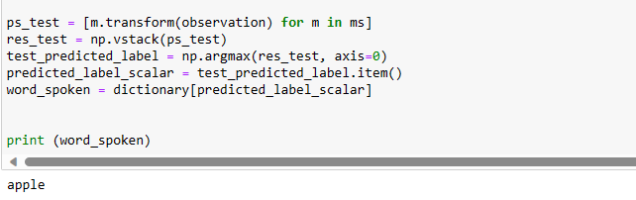
Text Output
12

Slide 13
Future Trends
Current research trends involve the integration of deep learning with HMM in speech recognition. These advancements are expected to lead to more accurate and robust speech recognition systems.

Slide 14
Conclusion
We have discussed the speech recognition system using HMM and the techniques used in each stage of speech recognition system are discussed. Through this over review it is found that STFT is used widely for feature extraction of speech because it is noise robust and HMM is best among all modeling techniques as it increases recognition accuracy and speed.

Slide 15
THANK YOU

